Slide 1
Global Superstore Sales
By- Kumar Dushyant Patel

Slide 2
Dashboard Overview & Objectives
Overview:
This interactive dashboard, built in Power BI, provides a high-level analysis of sales performance across time periods, geographical regions, and product categories, using the Global Superstore dataset.
Objectives:
Analyze monthly sales trends to identify seasonal performance patterns.
Compare sales distribution across regions to spot high and low-performing markets.
Evaluate category-wise sales performance for product-level insights.
Derive data-driven insights to support strategic sales decisions

Slide 3
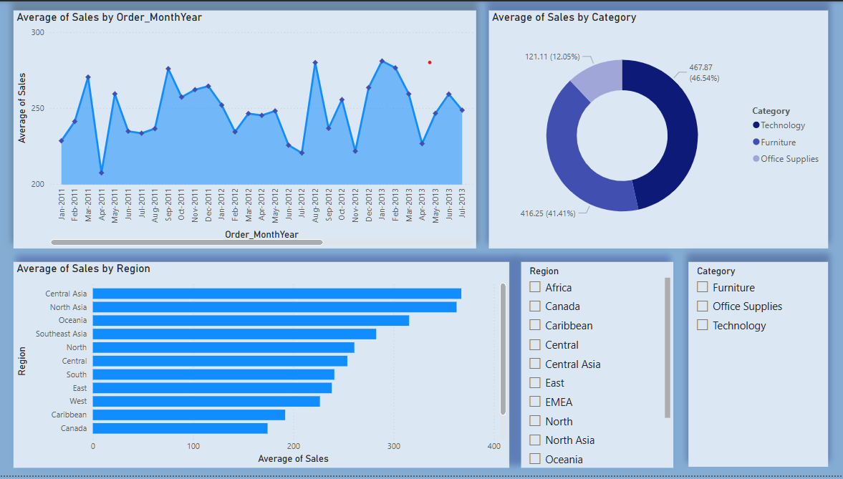
Insights

Slide 4
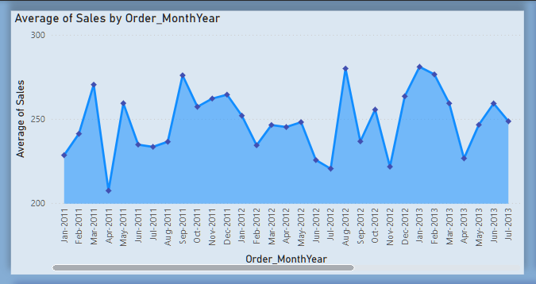
Monthly Sales Trend Analysis
February 2013 recorded the highest average sales, marking the peak of performance across the timeline.
July 2012 witnessed the lowest average sales, indicating a significant slowdown during that period.
There's no consistent growth, indicating seasonal buying behavior or campaign-based spikes.
A clear seasonal trend is observed:
Sales consistently peak in Q1 (Jan–Mar) and Q3 (Aug–Sep).
Sales tend to dip during Q2, especially in June–July.

Slide 5
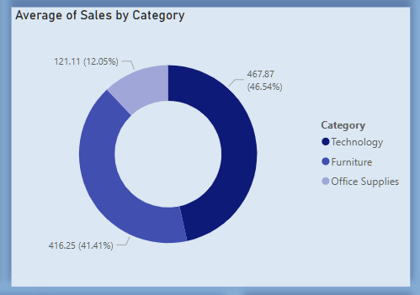
Sales Distribution by Category
Technology leads with 46.5% of total average sales.
Furniture follows closely with 41.4%, suggesting a strong market.
Office Supplies contributes the least at just 12.05%.
Insight: Business focus is primarily on Tech and Furniture – consider strategies to boost Office Supplies.

Slide 6
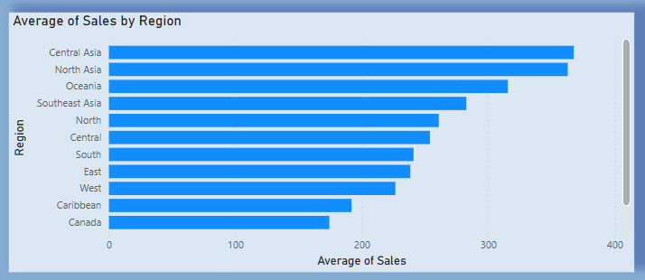
Regional Sales Comparison
Central Asia region leads with the highest average sales, establishing itself as the strongest performing region.
North Asia region follows closely behind, showing consistent high-value sales performance.
East region shows moderate sales averages, contributing steadily but not at peak levels.
West region has the lowest average sales, indicating a potential need for strategic improvements.
Suggests strong presence in Asian markets.
The regional disparity highlights opportunities to boost low-performing regions like West and optimize campaigns in top areas like Central and North.

Slide 7
Summary
🔹 Sales Trend Over Time: Sales fluctuated across months, with peak sales observed in March 2011 and May 2013, while July 2012 had the lowest recorded sales. The trend suggests periodic spikes, indicating seasonal demand or campaign impacts.
🔹 Region-Wise Performance: The Central region recorded the highest average sales, followed by North and East. In contrast, the West region showed the lowest performance, highlighting areas for focused improvement.
🔹 Category Performance:
Technology emerged as the most profitable category, leading in average sales. Furniture showed steady performance, while Office Supplies had the lowest average, pointing to lower-value or frequent but smaller orders.

Slide 8
Thank You

